Slide 1

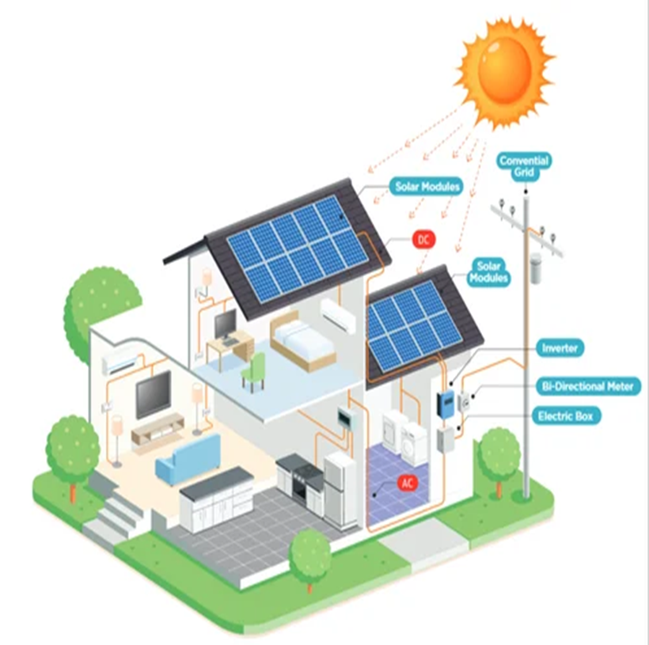
NISHITHA DEGREE COLLEGE
SMART HOME ENERGY MANAGEMENT SYSTEM
USING NODE.JS AND MONGODB
Presented by :
SHAIK NASEERODDIN
(5174-23-862-089)

Slide 2
CONTEXT :
INTRODUCTION
REQUIREMENTS
SYSTEM DESIGN
SYSTEM IMPLEMENTATION
TESTING CONCEPTS
SYSTEM REQUIREMENT SPECIFICATION
OUTPUT SCREEN
CONCLUSION

Slide 3

INTRODUCTION
The Smart Home Energy Management System is designed to monitor and manage energy usage in households. It uses modern technologies like Node.js, MongoDB, and the ARIMA model to forecast energy consumption and display usage trends through a web dashboard.
Purpose of the SHEMS:
To track energy usage in real-time
To analyze and visualize consumption patterns
To forecast future energy needs using ARIMA
To reduce energy waste and costs
To support energy-efficient smart living

Slide 4
REQUIREMENTS :-
Software Requirements
Hardware Requirements
Operating System : Windows 10 or higher
Backend Server : Node.js
Front End : HTML, CSS
Scripting : JavaScript
Forecasting Model : ARIMA (Python)
Database : MongoDB
Database Tool : MongoDB Compass / MongoDB Atlas
Programming Languages : JavaScript, Python
Visualization Library : Chart.js
Operating System : Windows 7 or higher
Processor : Intel Core processor or above
RAM : 4 GB or above
Hard Disk : 40 GB or above

Slide 5
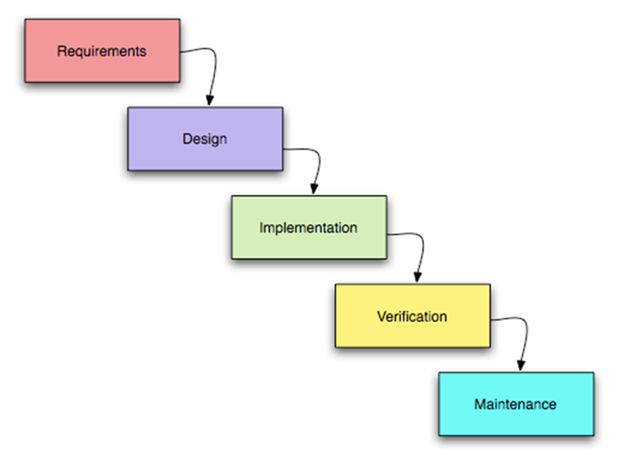
THE SEQUENTIAL PHASES IN WATERFALL MODEL ARE :-
Waterfall Model is efficient for this project because the life cycle of each phase is completed in sequence and then the results of the phase flow on to the next phase. There is no going back once the phase is completed. This process defines definite starting and ending points of a project. It is short-term project, so the waterfall is suitable for this project.

Slide 6
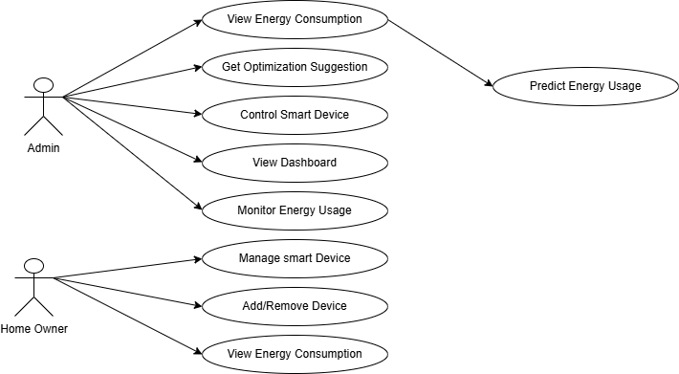
SYSTEM DESIGN :-
Use Case Diagram:-

Slide 7
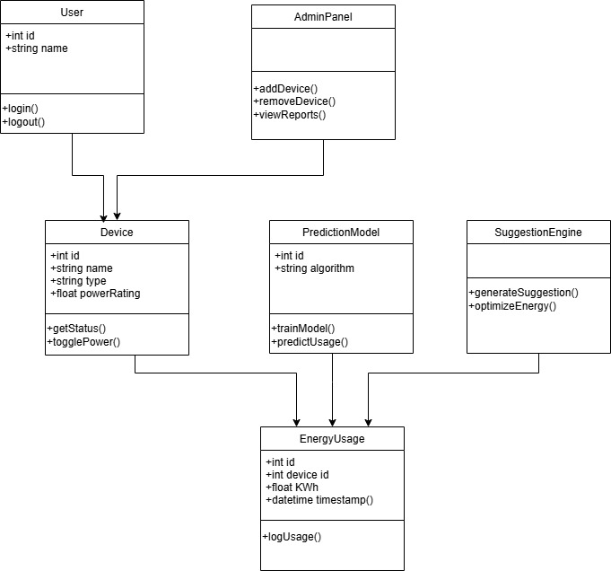
Class Diagram :-

Slide 8
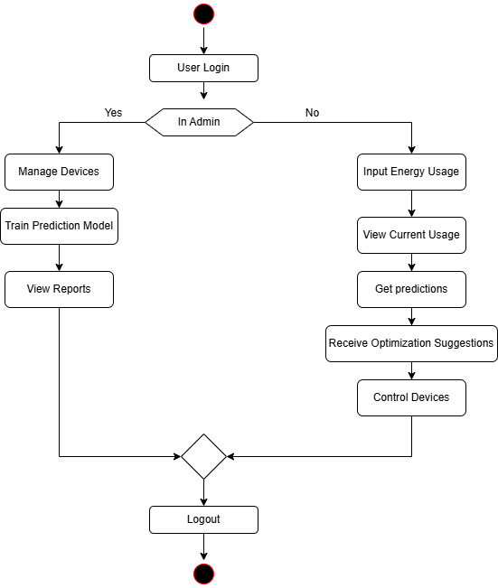
Activity Diagram:

Slide 9
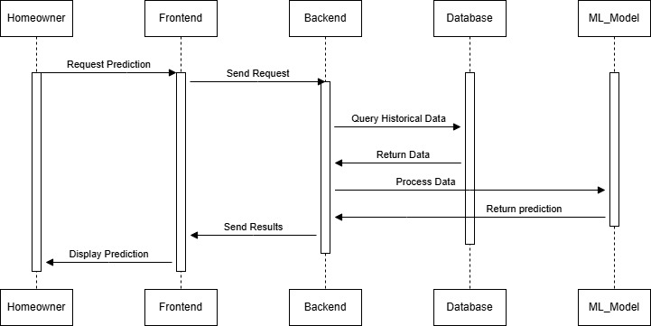
Sequence Diagram:

Slide 10
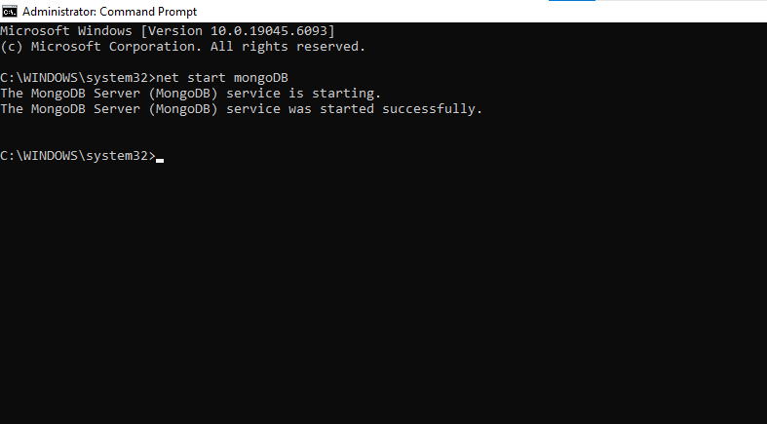
SYSTEM IMPLEMENTATION :-
Figure: MongoDb Starting in terminal

Slide 11
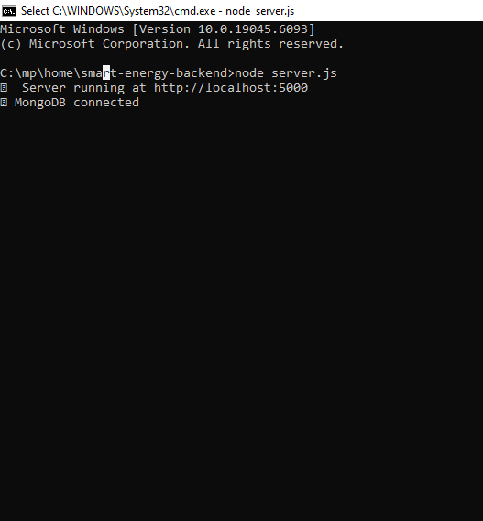
Figure:Node.js server running in terminal

Slide 12
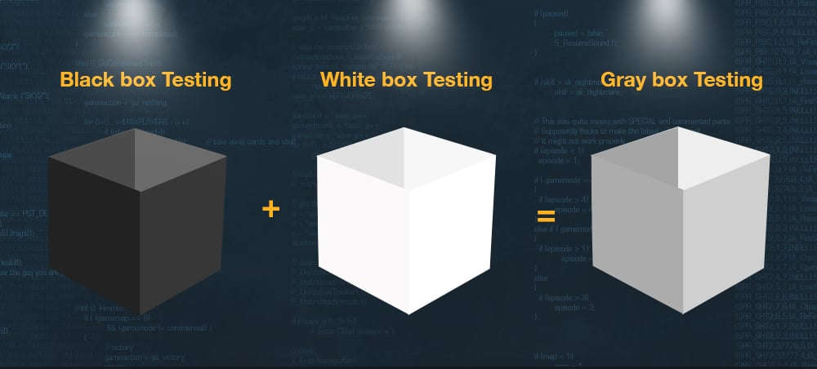
TESTING CONCEPTS :-
TESTING METHODOLOGIES

Slide 13
Testing Methodologies :-
Black box Testing: is the testing process in which tester can perform testing on an application without having any internal structural knowledge of application.
Usually Test Engineers are involved in the black box testing.
White box Testing: is the testing process in which tester can perform testing on an application with having internal structural knowledge. Usually The Developers are involved in white box testing.
Gray Box Testing: is the process in which the combination of black box and white box tonics’ are used.

Slide 14
LEVELS OF TESTING :-
UNIT TESTING
MODULE TESTING
INTEGRATION TESTING
SYSTEM TESTING
ACCEPTANCE TESTING

Slide 15
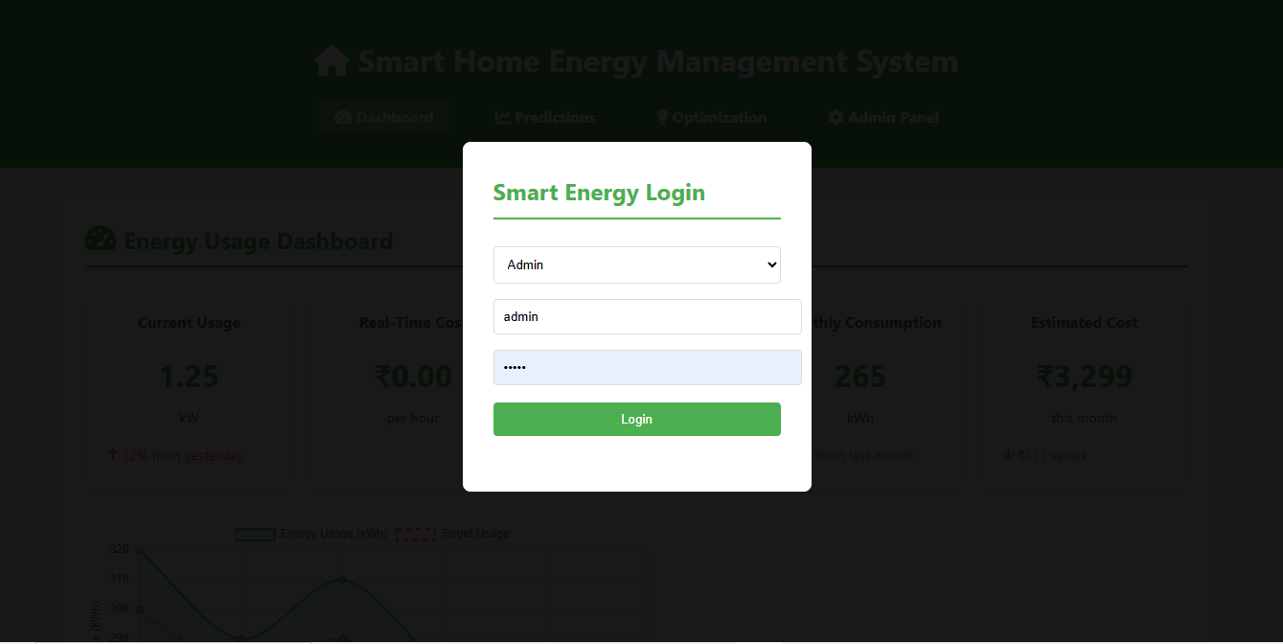
OUTPUT SCREENS :-
Admin Panel :-
Login page :

Slide 16
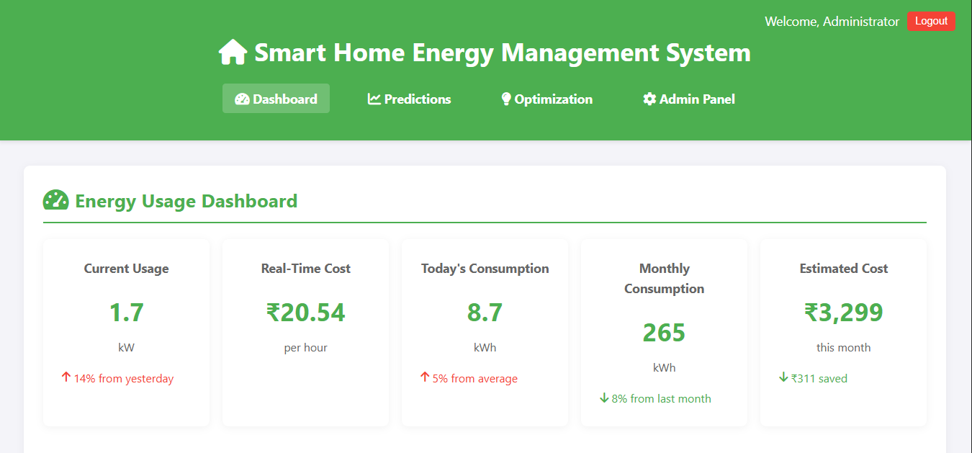
Energy Usage Dasboard

Slide 17
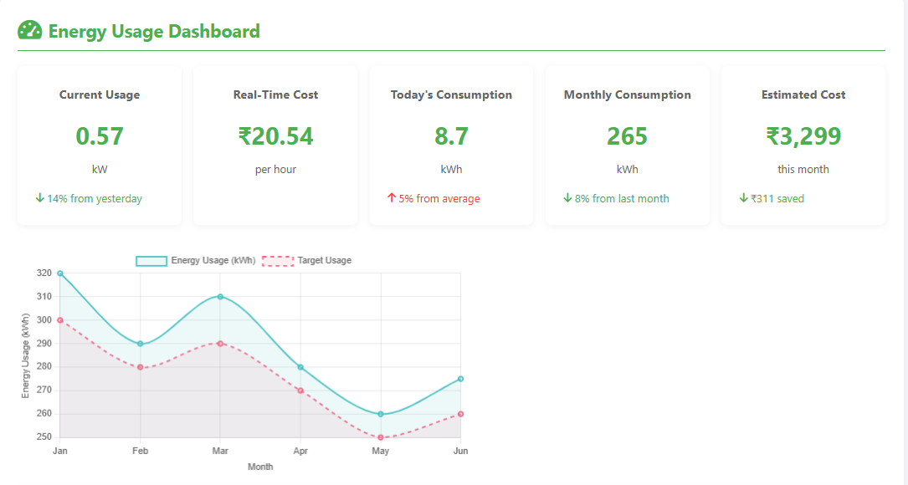

Slide 18
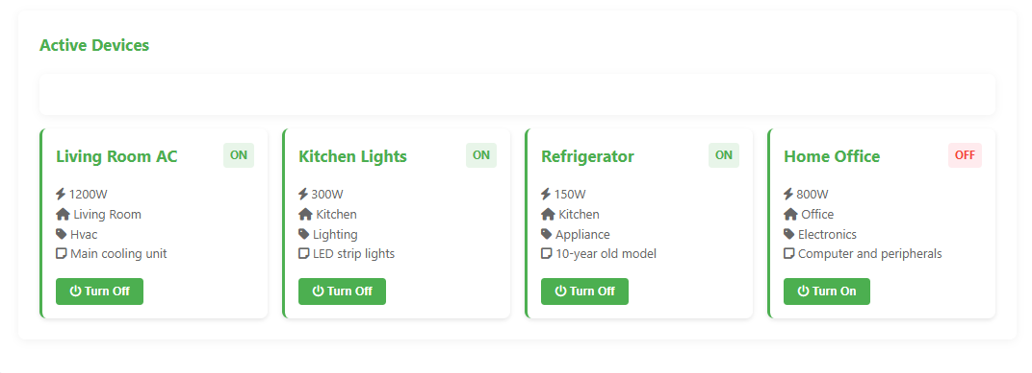
Active Devices

Slide 19
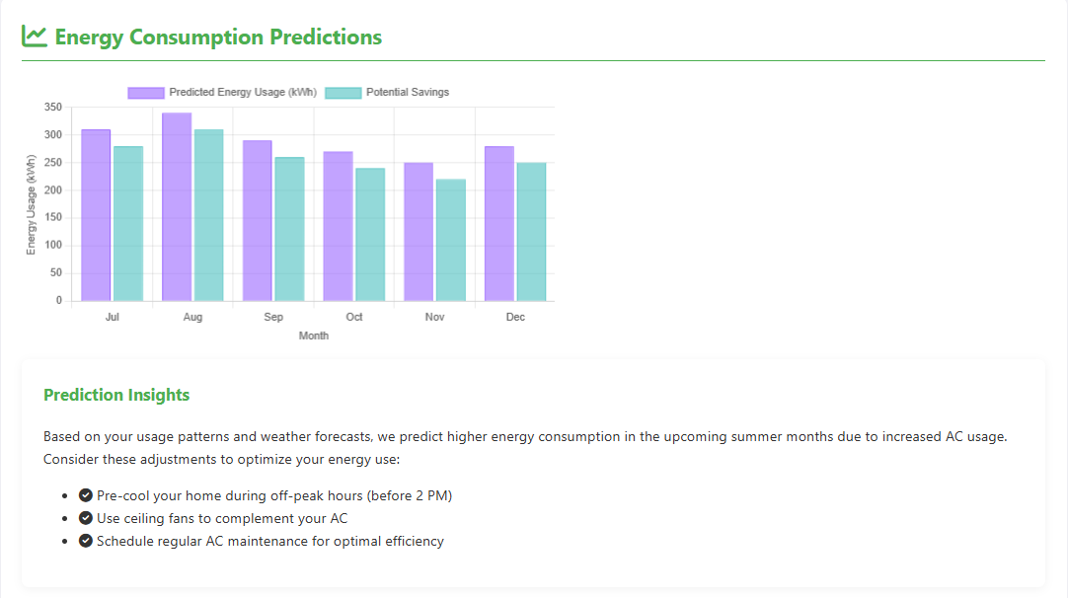
Energy Consumption Predictions:

Slide 20
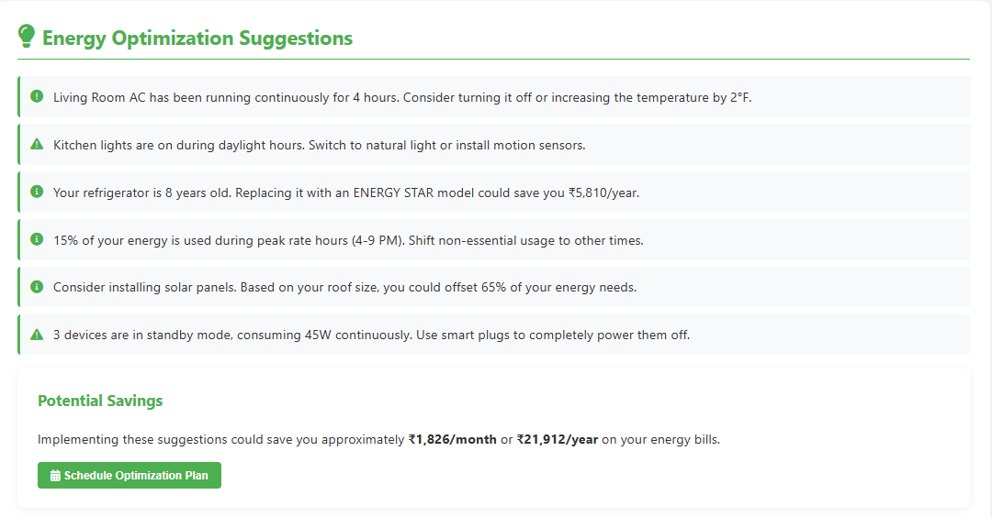

Slide 21
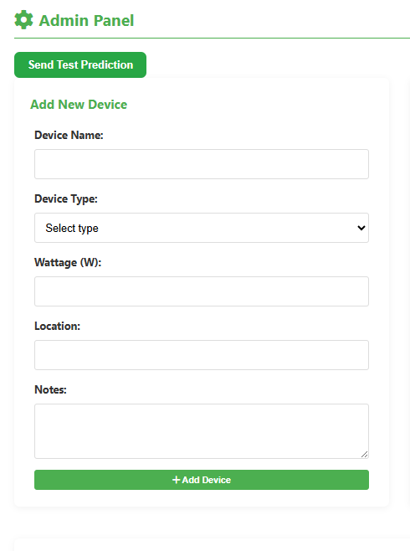
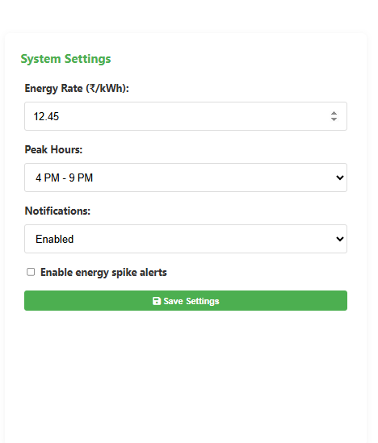
URL:https://smart-home-energy-management-system.onrender.com/

Slide 22
CONCLUSION
The Smart Home Energy Management System was successfully designed and implemented to track, predict, and optimize household energy usage. It integrates technologies like Node.js for backend, MongoDB for data storage, and ARIMA for accurate forecasting. The user-friendly interface provides real-time insights and promotes energy efficiency. The system reduces energy waste, supports cost-saving, and encourages sustainability. Testing confirmed its accuracy and reliability. It also offers scope for future improvements like IoT integration and mobile access.
GOALS ACHIEVED
Real-time energy usage monitoring
Accurate prediction using ARIMA model
User-friendly interface with dashboard charts
Admin panel for device control and reporting
Optimized energy usage suggestions
Scalable backend using Node.js and MongoDB
Reduced manual calculation and decision errors

Slide 23


